Slide 1
The Role and Effect of Sliver on SiC in TRISO Particles
Mahmoud Hawary
NE 795 – Fall 2021

Slide 2
Outline
Introduction
Fission Product/Coating Layer Chemical Interaction
Why Silver?
Ag Transport
Experimental Studies
Compactional Studies
US Vs. German Fuel
Effect of Fuel Kernel

Slide 3
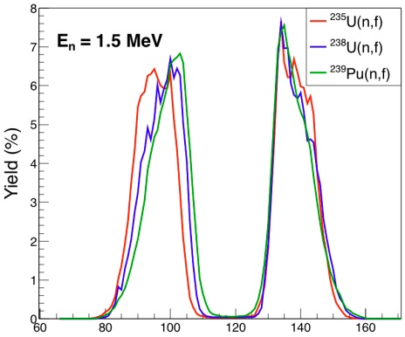
Introduction
TRISO fuel particles have been adopted as HTGR fuel because of their remarkable FPs retention capabilities.
The availability of FPs to interact with SiC layer depends on many variables.
The FPs could be divided into 4 different groups.
Grouping | Element/Phase
Fission gases and volatile FPs | Xe, Kr, I, Te, Rb, Cs, CsRb, CsI, CsBr, RbI, and RbBr
Metallic Precipitates | Mo, Pd, Rh, Ru, Tc, Ag, Sn, Sb, CdSe, Cs2Te, RbI, SrSe, Ag2Te, RuTe2, CdTe, SnIn, and SnTe
Oxide Phases | Mo, Nb, and Zr Oxides, Alkaline Earth Ba and Sr Oxides, Multi-component Oxide Phases (zirconates and molybdates), and Multi-Component Cs Oxides
Dissolved Stable Oxides | Zr, Sr and Rare Earths (Y, La, Ce, Pr, Nd, Pm, Sm, Eu, and Gd)
Notes:
factors including fuel composition, enrichment, burnup, fuel temperature, oxygen potential, and neutron spectrum

Slide 4
Fission Product/Coating Layer Chemical Interaction
Fission products can be transported from the kernel to the inner surface of the SiC. They interact and can cause damage and potentially fail the SiC layer.
In older uranium carbide kernel, rare earth FPs migration was of concern.
In UO₂ kernels, Palladium and other Nobel metals FPs are very important.
UCO form of the kernel generally ties up all fission products with the exception of some metals, e.g., Ag, Cs, Pd as either carbides or oxides → limit their mobility.
Silver migration in UO₂ and UCO has been observed → Not a failure mechanism.

Slide 5
Why Silver?
In 1984, a report has been published by GA and ORNL on the results of the PIE of the capsule HRB-15A.
This capsule has been irradiated in the ORNL High Flux Isotope Reactor (HFIR) from July 1978 to January 1979.
This fuel was irradiated to 26% FIMA and a peak fluence of 5.4x10²⁵ n/m² at a temperature of ~1100 ºC.
In some fuel types, 100% of the Ag has been released.
Historically, ^{110m}Ag has been observed to be released from seemingly intact fuel particles.
Recent PIEs from the AGR Fuel Development and Qualification Project have shown Ag, Ce, Eu, Pd and Sr to release from intact fuel.
^{110m}Ag could plate out on turbine components → formation of radioactive particulate → increase the exposure risk for maintenance workers and potential for releasing during accident.
The release of the FPs limits the overall lifetime of the reactors.

Slide 6
Ag Transport
The understanding of the FP release has been a research focus since the early 1970’s.
Ag release is still a topic of discussion as the responsible mechanism for the release has not been confirmed.
Two main competing hypothesis:
Microcrack vapor release
Grain boundary diffusion
There are many variations in the release rates determined from different experiments.
The scatter in the data is another challenge for fuel performance modelling.

Slide 7
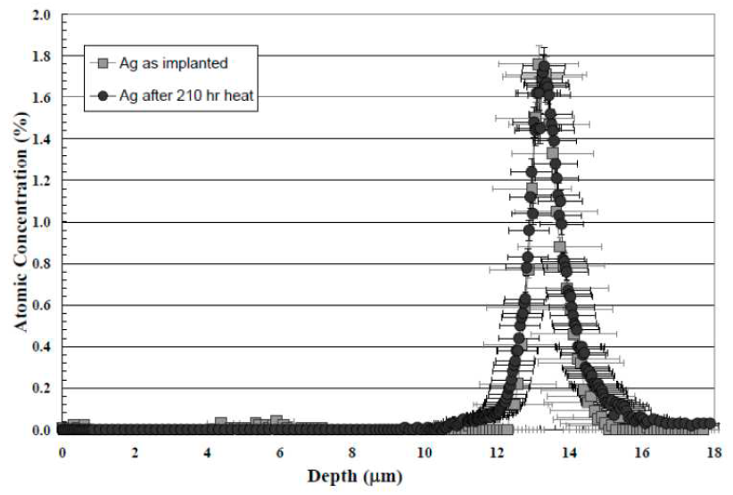
Experimental Studies
MacLean et al. indicated that Ag is to be immobile in the bulk SiC and release should be a result of the vapor phased transport.
They conducted two experiments to investigate Ag transport:
Implant Ag ions into thermally annealed polycrystalline SiC.
Two sets of implantation with different ion energies were carried out.
XPS has been used to investigate the Ag concentration.
The upper limit of the Ag diffusion rate obtained in this experiment is still much lower than the reported from plate out.
It has been assumed that recrystallization of the SiC implantation layer may have immobilized the Ag ions due to the high dose and the high damage in this area.

Slide 8
Experimental Studies
2. To measure Ag release, they placed Ag powder in a spherical SiC shell and incapsulated with a second deposit SiC layer.
The extent of the Ag release has been measured by weighting the sample before and after thermal exposure.
The shell design indicated measurable Ag had released from the shell through the SiC, but did not directly observe Ag in the SiC layers.
Authors conclude that Ag release is due to vapor transport mechanism along the microcracks in the SiC layer.
The same result has been obtained in the study by Xiao et al. who investigated the Ag diffusion in SiC using ion implantation in single crystals 4H-SiC.
It was concluded that Ag desorption from the surface and not diffusion is the dominant mechanism at elevated temperatures and the Ag transport was due to nano-pore or micro-crack transport.

Slide 9
Experimental Studies
On the other hand, a study by Friedland et al. on two SiC substrates, polycrystalline SiC and single crystal 6H-SiC using ion implantation observed a difference in the Ag diffusion between these two materials.
In the polycrystalline SiC, an implantation peak broadening has been observed.
In the single crystal, no significant change in the Ag concentration has been observed.
These observations suggest that the GBs play a role in the Ag transport.
Another experiment investigated the Ag transport using SiC/Ag/SiC sandwich (diffusion couples).
Transport of Ag is indicated by identifying Ag precipitates along GBs throughout the SiC layer.

Slide 10
Computational Studies
The kinetics of the Ag/SiC system have been modeled by ab initio and molecular dynamics (MD) by the Computational Materials Group at UW-Madison.
Both lattice and GB diffusion pathways were considered in the efforts to understand the role of microstructure on release.
The efforts focused on understanding the formation and migration energies, E_{f} and E_{m}, for individual defects and complex defect structures which participate in Ag transport.
They aimed to understand which diffusion mechanisms are active and contribute to impurity diffusion in polycrystalline SiC.
This study confirmed that the equilibrium lattice diffusion is unlikely to contribute to Ag release as the solubilities calculated from the formation energies are too low to contribute to significant atomic transport → agree with the experimental studies.

Slide 11
Studies Summary
Limited experimental evidence for impurity GB diffusion serving as fast diffusion pathways in SiC.
Self-diffusion of C in polycrystalline SiC has shown GB fast diffusion to be an active phenomena.
C self-diffusion determined D_{b} to be approximately 10⁵-10⁶ times faster than D_{l}.
The ab initio and MD simulation studies conclude that the energetics for GB diffusion are favorable over lattice diffusion, implying GB diffusion serves as a fast diffusion pathway.

Slide 12
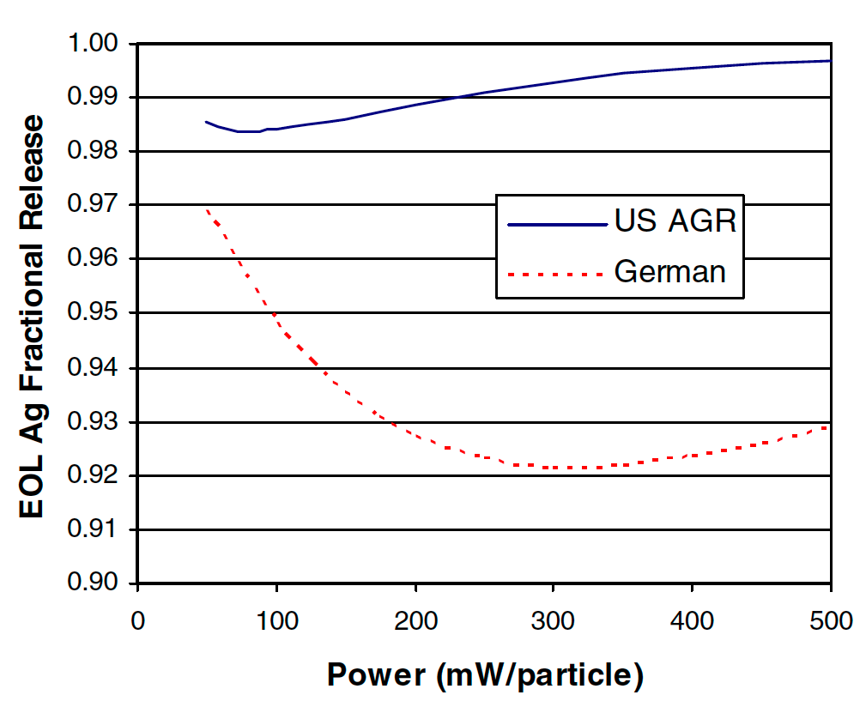
US Vs. German Fuel
Generally, the behavior of the FPs release is a complex function of time and temperature.
As power increases, the fractional release decrease due to less time available for diffusion.
This behavior continues until the diffusion rate increases sufficiently.
This increase is due to increasing temperature.
The increase due to increasing temperature will dominate over the irradiation time and release will start to increase with power.

Slide 13
US Vs. German Fuel
Experimental studies suggest that Ag release is a function of the microstructure of the SiC.
The German process results in small equiaxed grains whereas the US process produces larger columnar thru-wall grained SiC.
This difference in microstructure is believed to be primarily a function of temperature used during the SiC coating phase in the coaters. US use higher temperature.
The higher tortuosity in the German SiC allows for retaining metallic FPs better than the thru-wall columnar US SiC which has more direct GB pathways through the layer.
German
US

Slide 14
US Vs. German Fuel
The effect of the microstructure on the Ag release has been studied through two different SiC morphologies produced on US UCO fuel.
This fuel was irradiated to 26% FIMA at temperature ~1100 ºC.
Approximately, 90% of the Ag has been released from the large columnar grained SiC.
Only ~30% of the Ag has been released in the smaller grained SiC.

Slide 15
Effect of Fuel Kernel
UO2 with large columnar-grained SiC→ 100% Ag release
UC2 with weaker laminar SiC → 82% Ag release
UCO with laminar SiC → very little Ag release
We can’t make a definitive statement about the role of the SiC microstructure as these particles has different kernel types.
We can conclude that the SiC microstructure play a role in the Ag transport.

Slide 16
Conclusion
The Silver release has a serious impact on the overall lifetime of the reactors.
Exposure risk for maintenance workers.
Potential of release during an accident.
Degradation of SiC layer.
Two main hypothesis for Ag transport:
Vapor phased transport through microcracks
Grain boundary diffusion for either silver or silver precipitates.
The German TRISO fuel has a better FPs retention because of the equiaxed GBs for the SiC layer.
The kernel fuel has an impact of the Ag release but this behavior is still not full understood.

Slide 17
Questions?

Slide 18
Why Silver!
Silver has a complex release behavior from TRISO fuel.
Silver has been reported to be non-reactive.
Dissolution of SiC in contact with SiC has been observed above 1000 ºC.
Si is dissolved in molten Ag
Graphite is precipitated out

